Slide 1


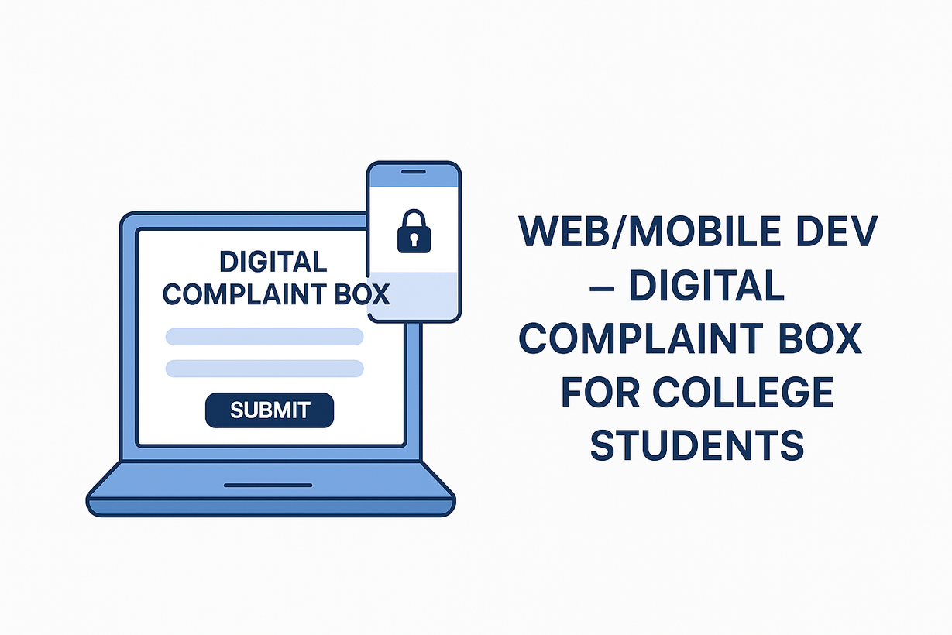

Web/Mobile Dev – Digital Complaint Box for College Students
Presented by - HACKOPS

Slide 2

TABLE OF CONTENTS
Introduction
Target Audience
Solution Overview
Market Potential
Detailed Explaination
Impact
Uniqueness and innovation
Team Details

Slide 3
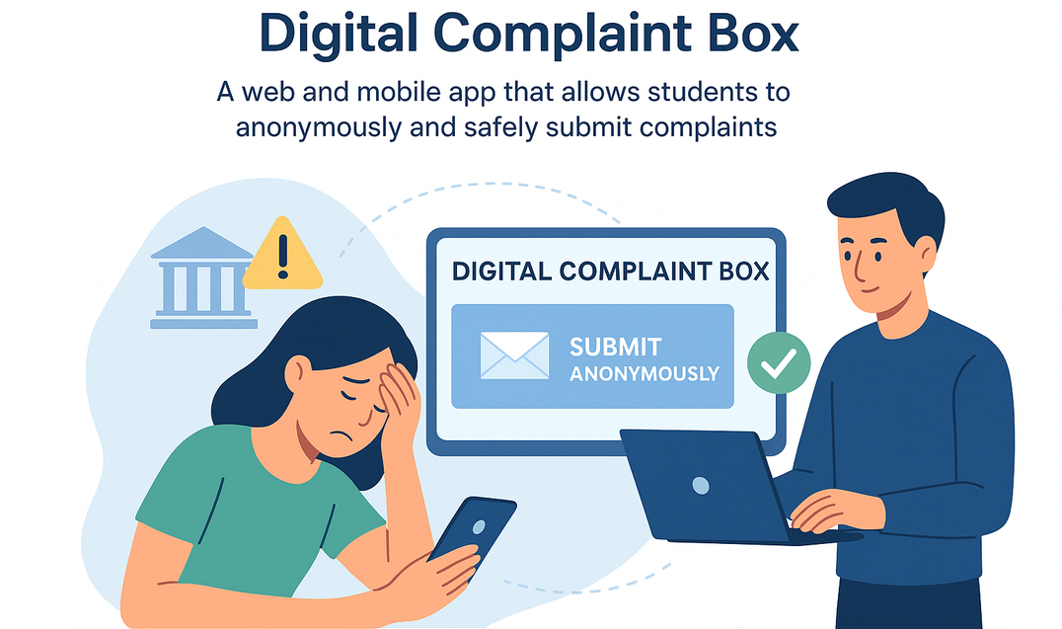


INTRODUCTION
Students often hesitate to report issues due to fear of exposure or inconvenient processes. This leads to unresolved concerns that affect campus life.
Our solution is a Digital Complaint Box — a web and mobile app that allows students to anonymously and safely submit complaints. It helps college authorities track, manage, and resolve issues efficiently, improving transparency and student well-being.
Your paragraph text

Slide 4
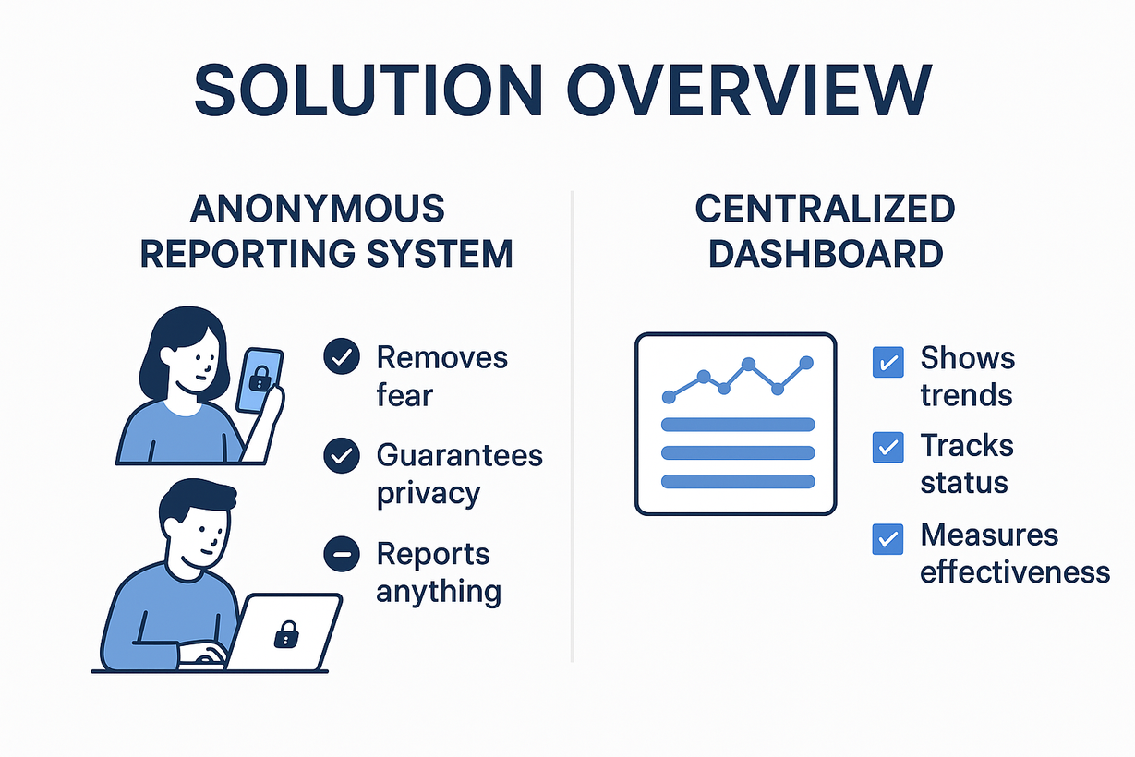
Anonymous Reporting System
Removes fear of exposure with anonymous online form/app.
Students can report anything — from small issues (broken bench) to serious concerns (harassment).
Guaranteed privacy builds confidence to speak up.
Centralized dashboard auto-organizes reports, shows trends, tracks status (received → in progress → resolved), and measures response effectiveness.
Creates a cycle of safe reporting + actionable insights, improving campus life.

Slide 5


DETAILED EXPLAINATION
Think of our solution as a digital bridge between students and the administration. The magic happens behind the scenes with a powerful full stack system. On the student's side, we've built a sleek, user-friendly app that feels right at home on their phone or web browser. It's built with modern tools to ensure a seamless experience where submitting a complaint is as easy as sending a message. They can type, click a category, snap a photo, and hit submit. It’s all intuitive, fast, and designed with a modern user in mind.
Once they hit 'send,' our powerful back-end takes over. It acts as the central brain, securely receiving the complaint and logging it in a robust, flexible database. This back-end is not just a storage system; it’s an intelligent router. It automatically sorts the complaint and presents it on a secure admin dashboard, so the right person in the college can see it instantly.
From there, the admin can take action—assign it, change its status, and provide a response. The coolest part? This all happens in real-time. Students get an instant notification, closing the loop and showing them that their voice was not just heard, but acted upon. It’s a complete, start-to-finish solution that puts an end to endless email chains and forgotten complaints.

Slide 6
INNOVATION AND UNIQUENESS
Unique Aspects
Anonymous but actionable
Centralized & auto-categorized
Transparent status tracking
AI moderation & prioritization
Trend analysis & insights
Student empowerment
Boosts college reputation
Why Different?
✅ Privacy + Trust
✅ Organized Dashboard
✅ Visible Outcomes
✅ Data-driven Improvements

Slide 7
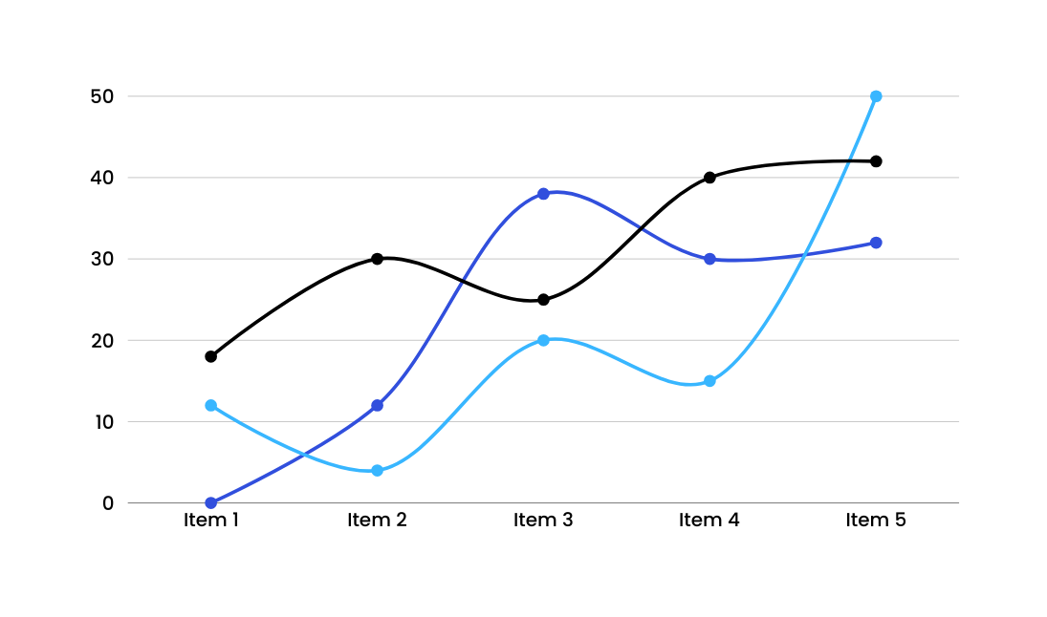
TARGET AUDIENCE
Students – hesitant to report due to fear of exposure or being ignored.
Academic Issues – exams, faculty, grading, curriculum.
Administrative Issues – fees, hostel, library, operations.
Social/Campus Issues – ragging, harassment, bullying, discrimination.
Suggestions & Feedback – ideas for facilities, teaching, welfare.
Psychological Safety – safe space for sensitive concerns.

Slide 8




MARKET POTENTIAL
Growing need for secure, anonymous grievance platforms due to student rights, safety & mental health.
40M+ students in India (1,100+ universities, 43,000+ colleges); huge global scope.
Regulatory Push → UGC/NAAC mandate grievance mechanisms; current systems outdated.
Tech Fit → Rising smartphone use + digital campuses → mobile-first, encrypted solutions.
Scalable → From universities → schools → corporate institutes.

Slide 9

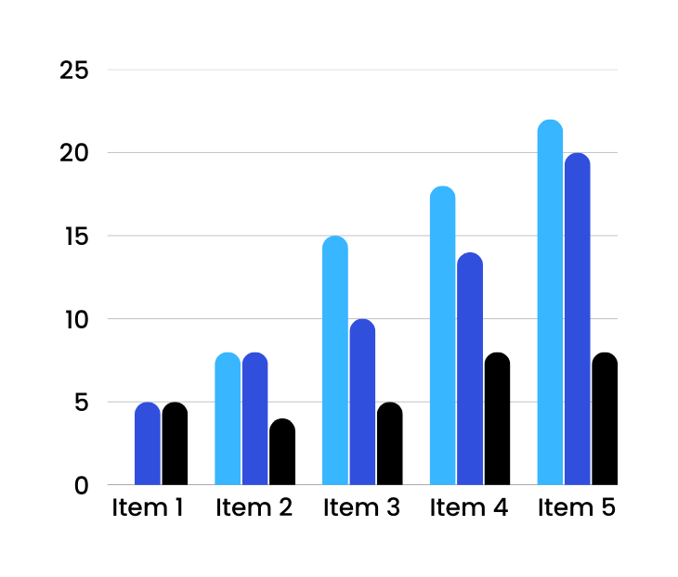
IMPACT
Students → Safe & anonymous reporting, psychological safety, constructive feedback.
Colleges/Universities → Transparent handling, regulatory compliance, improved reputation, data-driven insights.
Society/Education → Prevents harassment/self-harm, promotes welfare & inclusivity, builds open dialogue culture.

Slide 10
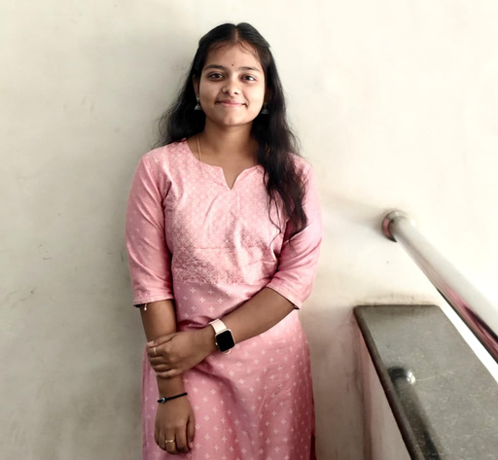
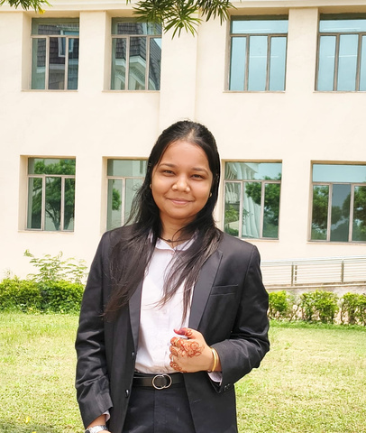
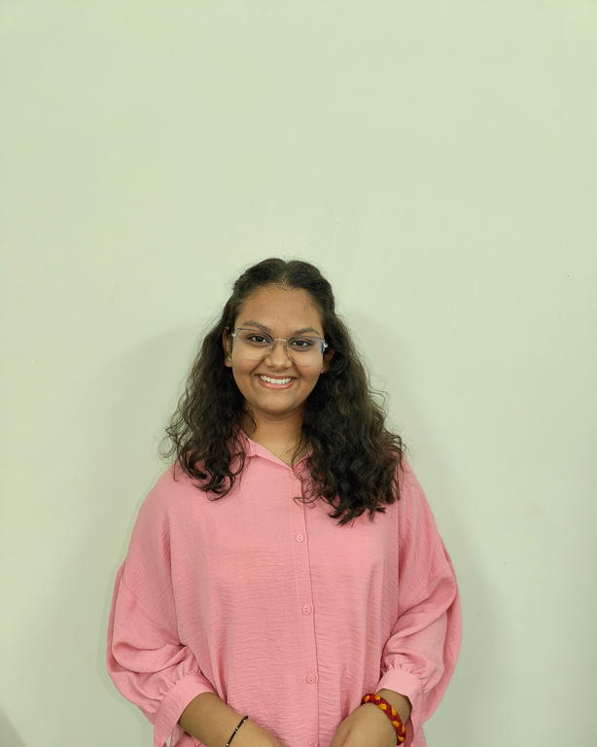
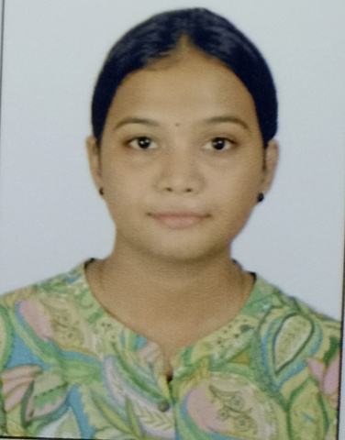
OUR TEAM
L. NISHITA
ANUKRITI SONI
TEAM LEADER
MEMBER-2
SHRADDHA DANSENA
PRATIKSHA WAGHMARE
MEMBER-3
MEMBER-4

Slide 11
THANK YOU
FOR ATTENTION

